Slide 1

Adventure Work Cycle Project Transforming numbers into insights

Slide 2
04
Recommendation and conclusion
02
KPI INSIGHTS
03
DASHBOARD EXPLNATION
01
INTRODUCTION
CONTENT

Slide 3
02
KPI INSIGHTS
03
DASHBOARD EXPLNATION
04
Recommendation and conclusion
CONTENT
01
INTRODUCTION

Slide 4



Introduction
Welcome to the Adventure Work Cycles Data Analytics Project, where we analyze key performance metrics to enhance business operations, customer satisfaction, and overall performance.
This study leverages the Adventure Work Cycles Dataset, providing critical insights into sales trends, customer preferences, product performance, and regional market dynamics.
The dataset provides insights into product types, including bikes and accessories, regional sales performance across key markets, customer purchasing patterns and preferences, revenue metrics such as sales figures and profit margins, and inventory status with a focus on stock levels and supply chain efficiency.

Slide 5
Problem statement
Adventure Works Cycle seeks to strengthen its business decision-making by harnessing the power of data analytics. Despite offering a wide range of products and operating across global markets, the company faces challenges in:
Analyzing sales performance across regions and product categories
Gaining insights into customer preferences, feedback, and satisfaction
Optimizing product availability across online and in-store channels.
To address these challenges, this project utilizes tools such as Excel, Tableau, Power BI, and SQL to uncover actionable insights. The goal is to enhance customer experience, improve sales performance, and enable smarter, data-driven strategies for sustainable growth.

Slide 6




Key metrics and business insights
TOTAL PROFIT
$12.08 million
TOTAL CUTOMERS
18,484k
TOTAL SALES
$29.35 million
The company has achieved a healthy profit, indicating effective pricing strategies and cost management across most product lines.
TOTAL COST
$17.27 million
A robust and balanced customer base, with 9,351 male and 9,133 female customers, highlights broad brand appeal and strong engagement.
Sales performance is strong, indicating high product demand and good market penetration.
Costs are well-managed relative to revenue, indicating an efficient supply chain and production process.

Slide 7
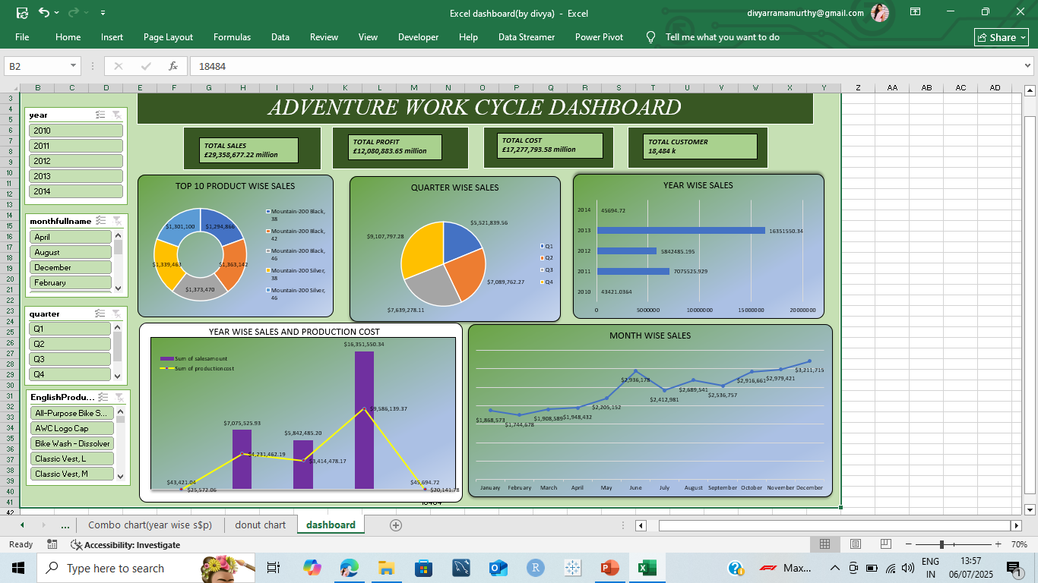
Excel dashboard

Slide 8
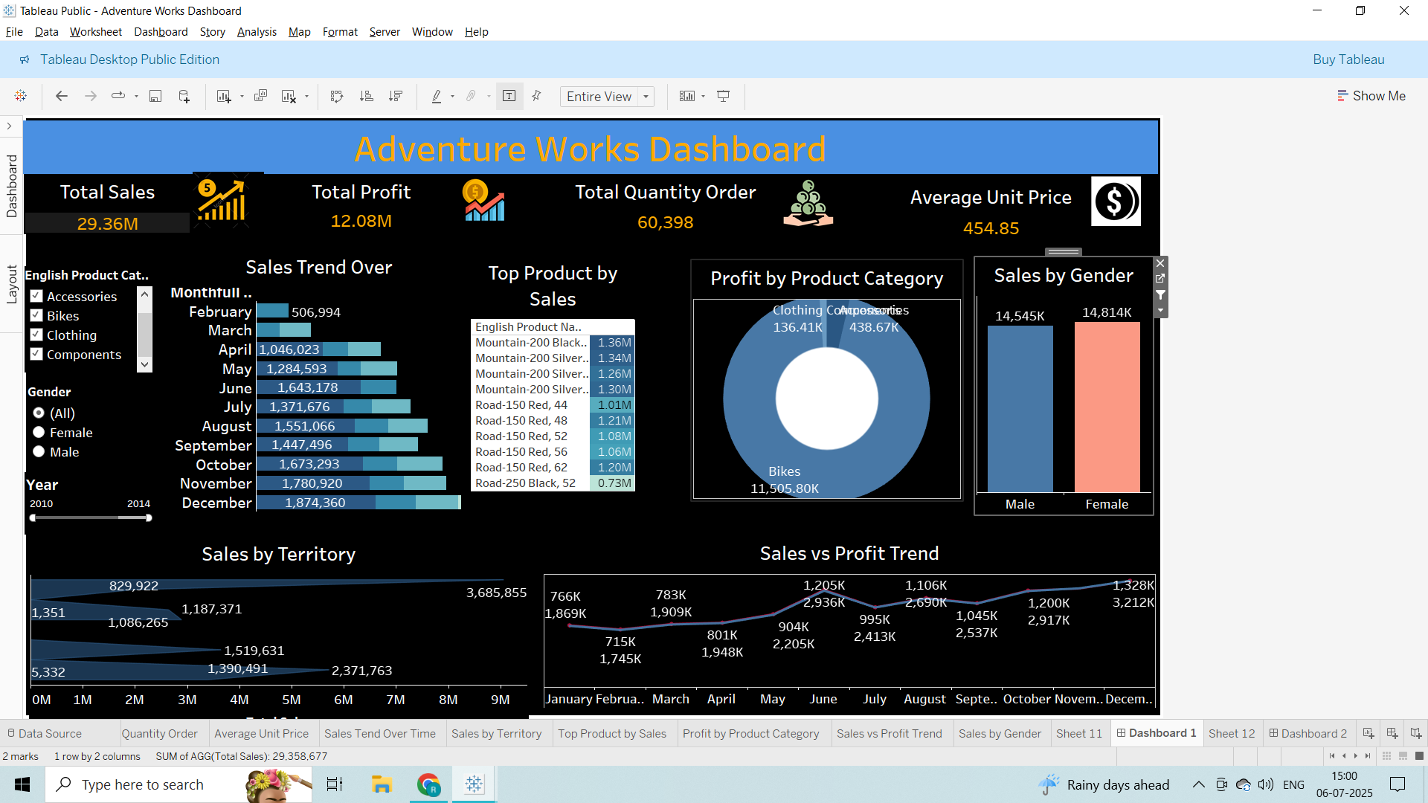
TABLEAU DASHBOARD

Slide 9
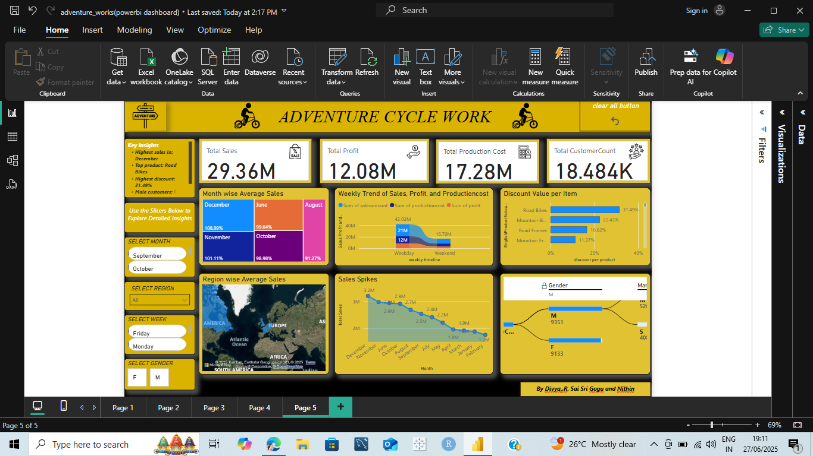
Power bi DASHBOARD

Slide 10
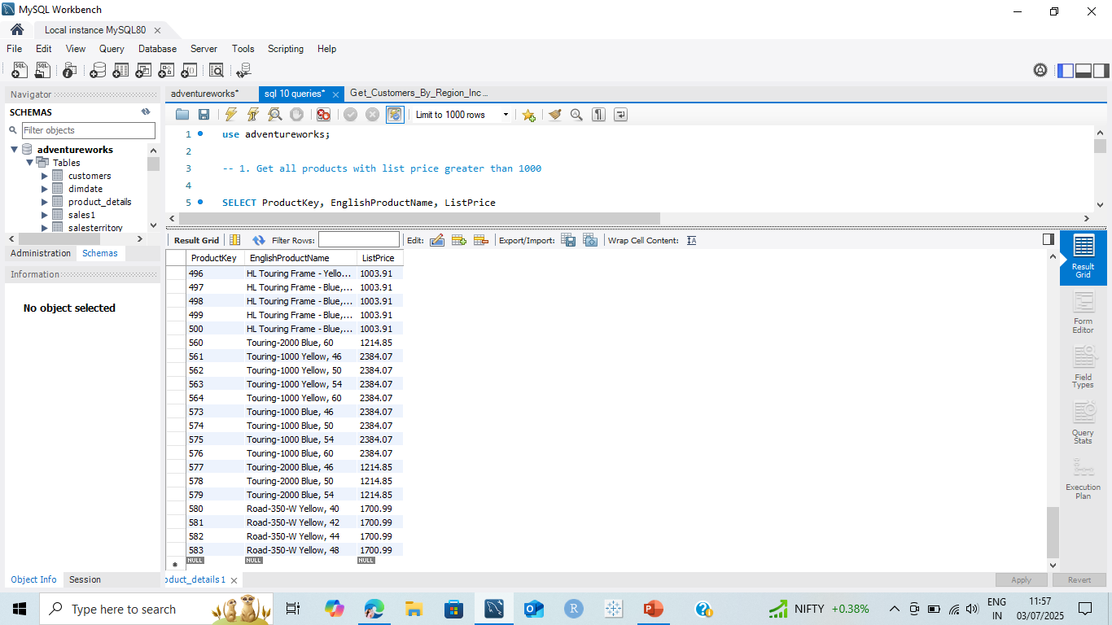
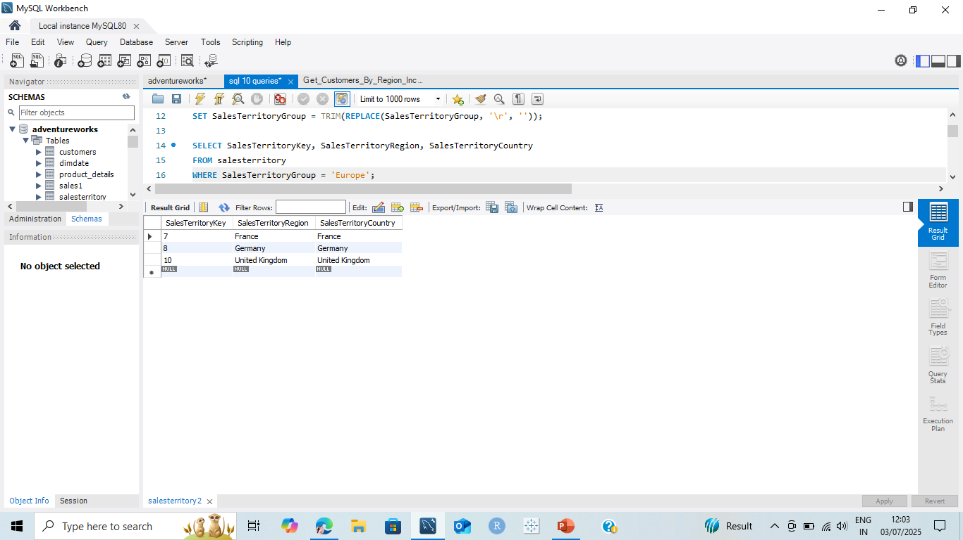
Sql queries
1. Get all products with list price greater than 1000
SELECT ProductKey, EnglishProductName, ListPriceFROM product_detailsWHERE ListPrice > 1000;
2. List all sales territories in Europe
UPDATE salesterritorySET SalesTerritoryGroup = TRIM(REPLACE(SalesTerritoryGroup, '\r', ‘’));
SELECT SalesTerritoryKey, SalesTerritoryRegion, SalesTerritoryCountryFROM salesterritoryWHERE SalesTerritoryGroup = 'Europe';

Slide 11
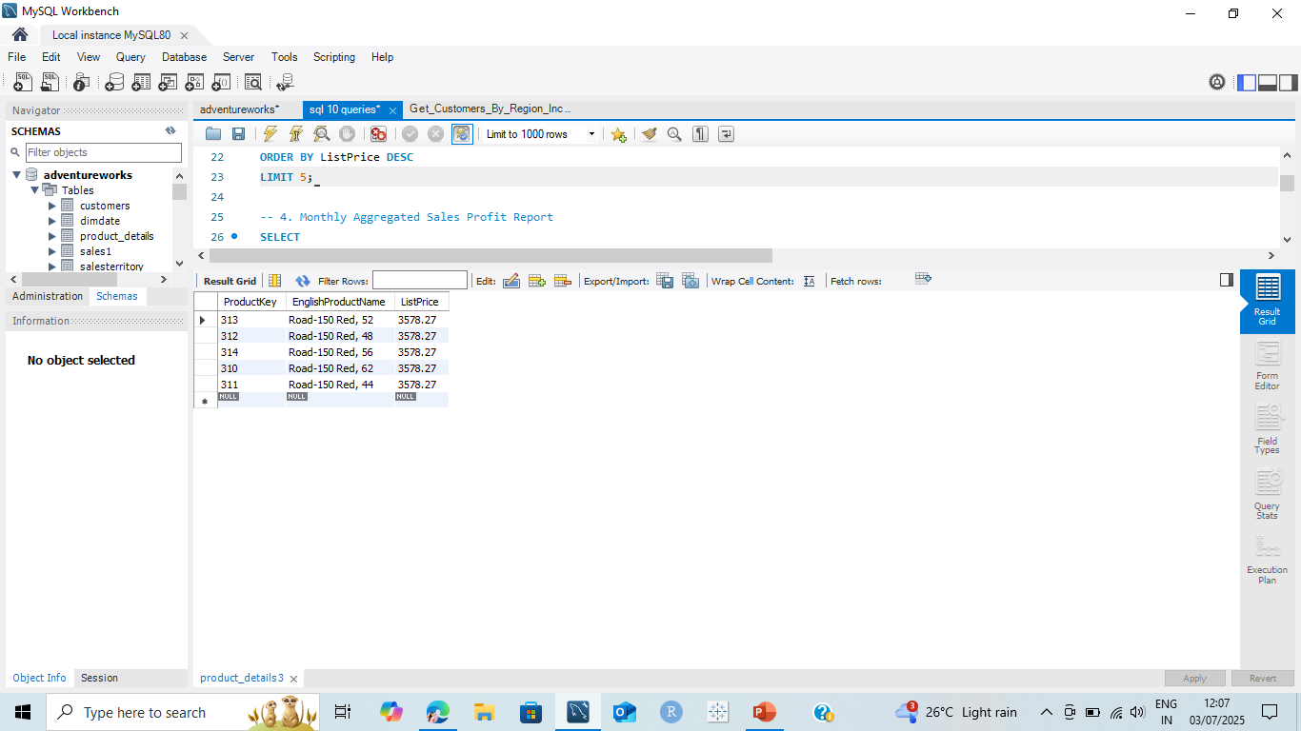
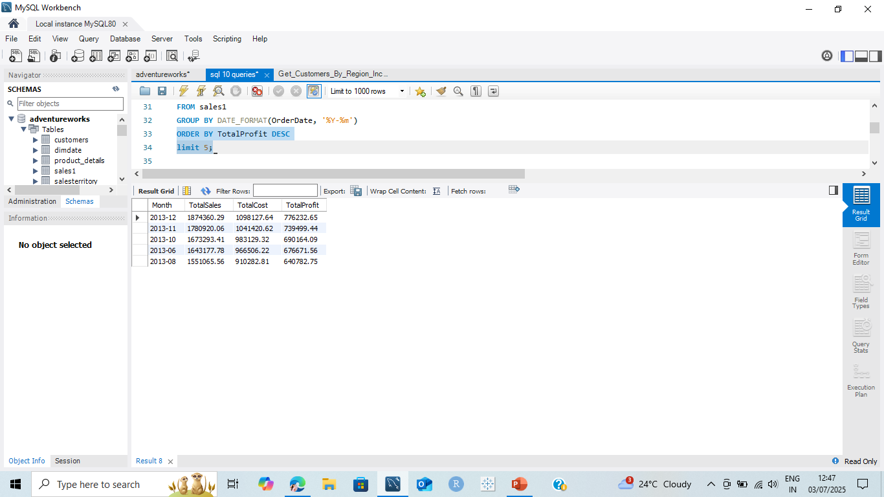
3. List top 5 most expensive products by list price
SELECT ProductKey, EnglishProductName, ListPriceFROM product_details ORDER BY ListPrice DESC LIMIT 5;
4. Monthly Aggregated Sales Profit Report
SELECT DATE_FORMAT(OrderDate, '%Y-%m') AS Month,
SUM(SalesAmount) AS TotalSales,
SUM(ProductionCost) AS TotalCost,
SUM(SalesAmount - ProductionCost) AS TotalProfit FROM sales1 GROUP BY DATE_FORMAT(OrderDate, '%Y-%m’) ORDER BY TotalProfit DESC limit 5;

Slide 12
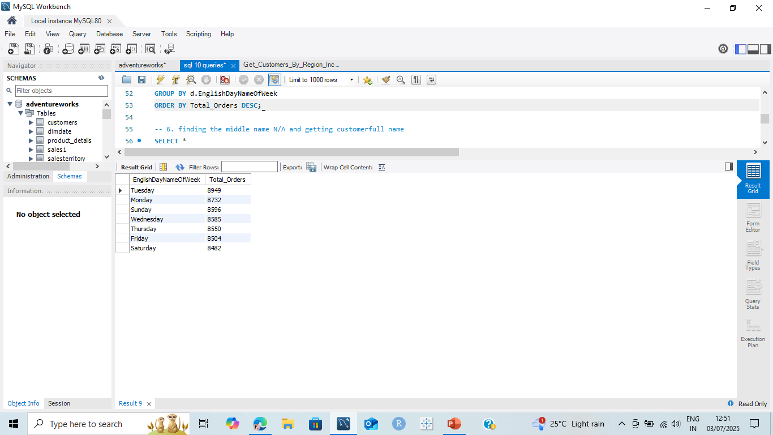
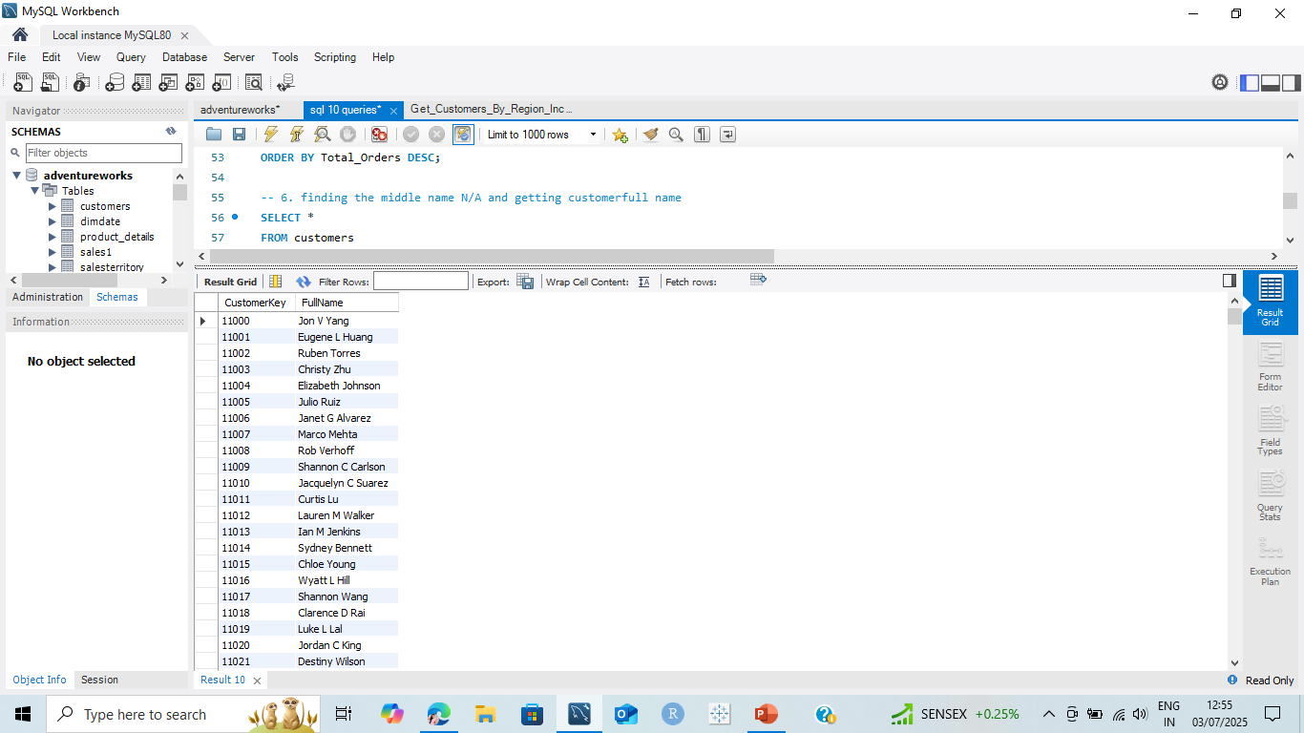
5. Join sales1 and dimdate to see sales by weekday
SELECT d.EnglishDayNameOfWeek, COUNT(*) AS Total_Orders FROM sales1 s JOIN dimdate d ON s.OrderDateKey = d.DateKey GROUP BY d.EnglishDayNameOfWeek ORDER BY Total_Orders DESC;
6. finding the middle name N/A and getting customerfull name
SELECT *FROM customersWHERE LOWER(MiddleName) = 'N/A’;
SELECT CustomerKey, CONCAT_WS(' ', FirstName, NULLIF(MiddleName, 'N/A'), LastName ) AS FullName FROM customers;

Slide 13
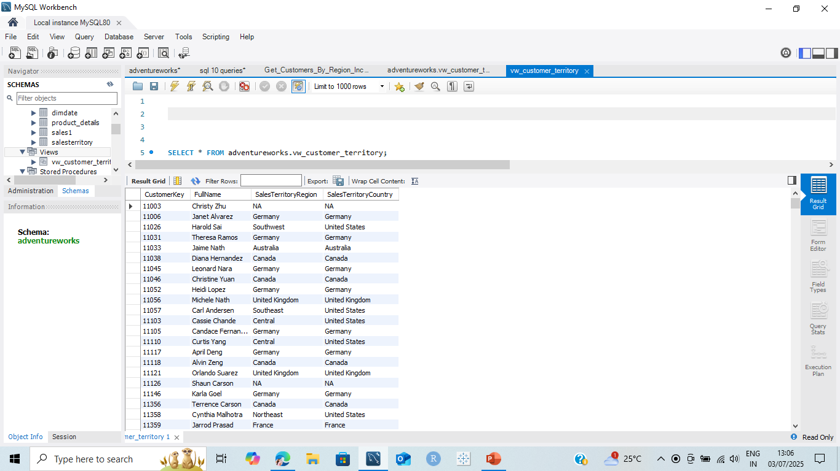
7. view
CREATE
ALGORITHM = UNDEFINED
DEFINER = `root`@`localhost`
SQL SECURITY DEFINER
VIEW `adventureworks`.`vw_customer_territory` AS
SELECT
c.CustomerKey AS CustomerKey,
CONCAT(c.FirstName, ' ', c.LastName) AS FullName,
s.SalesTerritoryRegion AS SalesTerritoryRegion,
s.SalesTerritoryCountry AS SalesTerritoryCountry
FROM
adventureworks.customers c
JOIN adventureworks.salesterritory s
ON c.GeographyKey = s.SalesTerritoryKey;

Slide 14
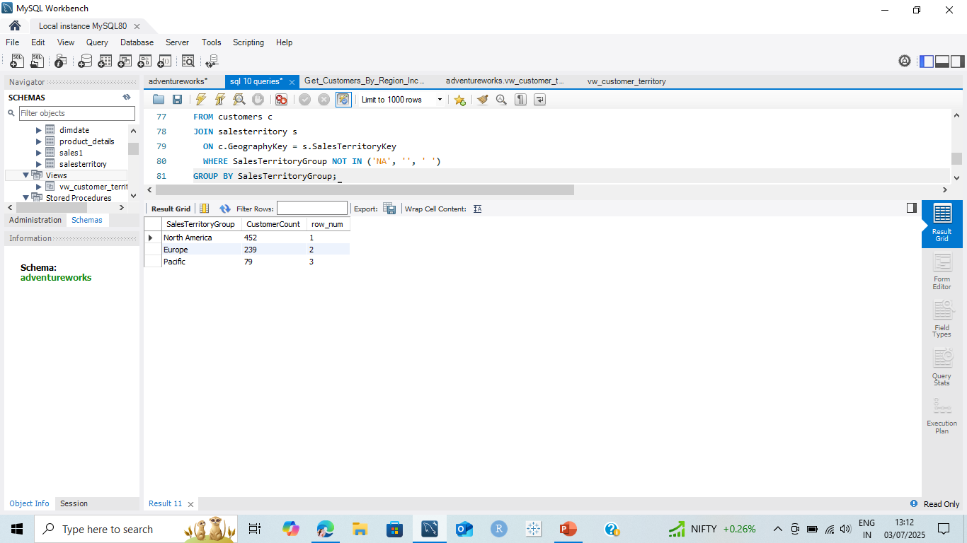
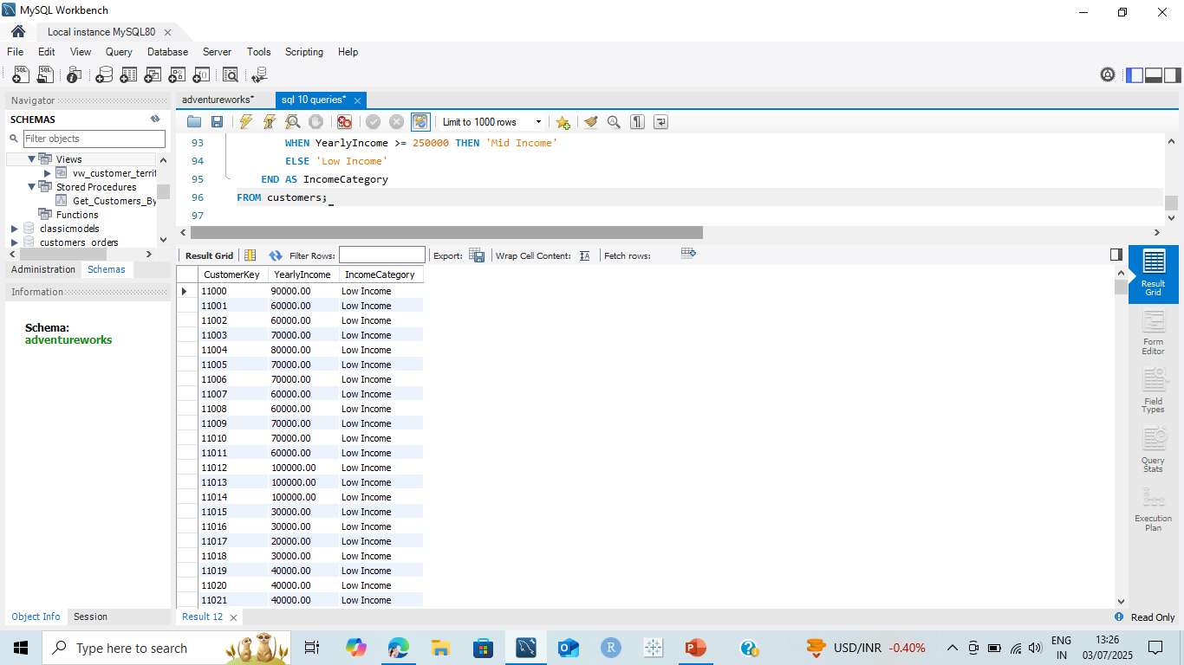
8. Get top 3 territories by customer count using rank
SELECT SalesTerritoryGroup, COUNT(CustomerKey) AS CustomerCount, ROW_NUMBER() OVER
(ORDER BY COUNT(CustomerKey) DESC) AS row_num FROM customers c JOIN salesterritory s ON c.GeographyKey = s.SalesTerritoryKey
WHERE SalesTerritoryGroup NOT IN ('NA', '', ' ')GROUP BY SalesTerritoryGroup;
9. conditional case
SELECT CustomerKey, YearlyIncome, CASE
WHEN YearlyIncome >= 500000 THEN 'High Income' WHEN YearlyIncome >= 250000 THEN 'Mid Income' ELSE 'Low Income' END AS IncomeCategory FROM customers;

Slide 15
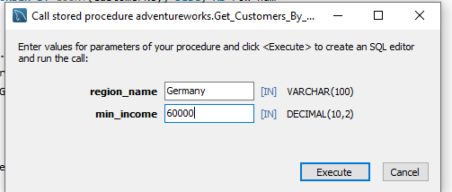
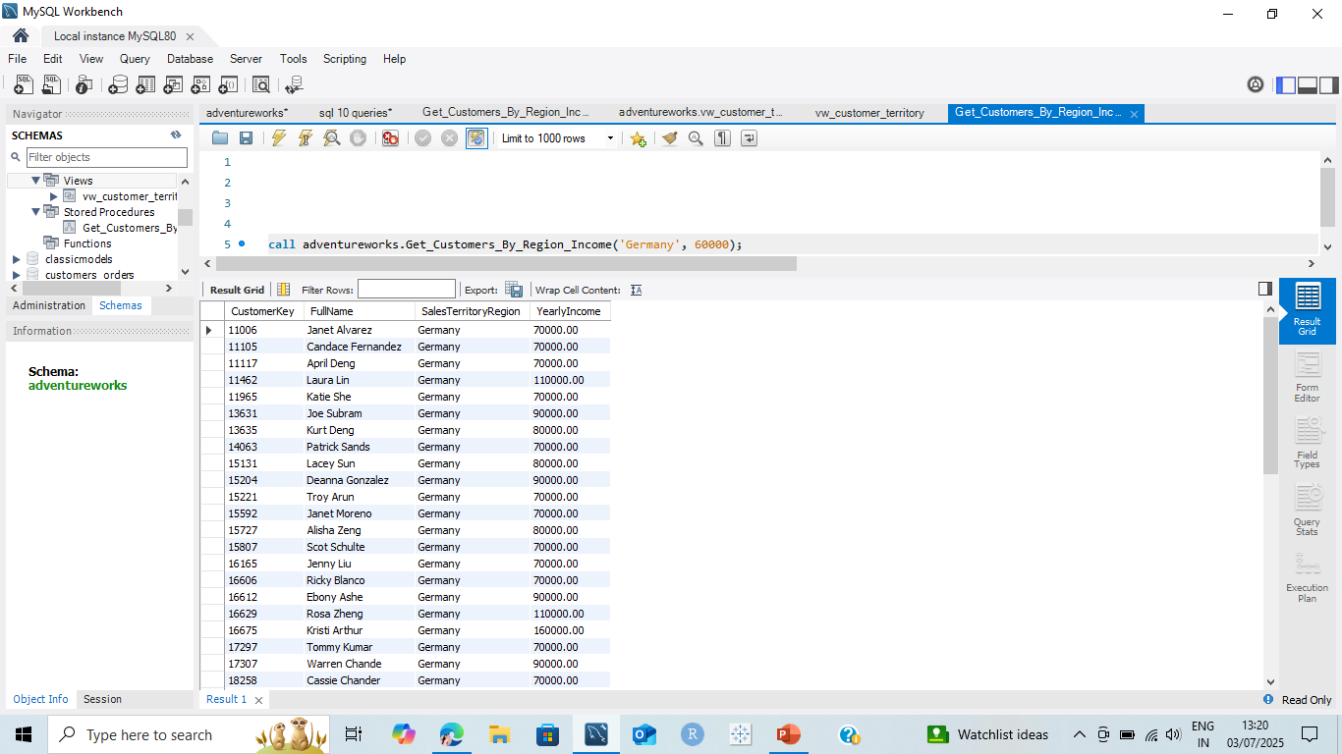
10 .Store procedure
CREATE DEFINER=`root`@`localhost` PROCEDURE `Get_Customers_By_Region_Income`(IN region_name VARCHAR(100),
IN min_income DECIMAL(10,2) )
BEGIN
SELECT c.CustomerKey, CONCAT(c.FirstName, ' ', c.LastName) AS FullName,
s.SalesTerritoryRegion, c.YearlyIncome FROM customers c
JOIN salesterritory s ON c.GeographyKey = s.SalesTerritoryKey WHERE s.SalesTerritoryRegion = region_name AND c.YearlyIncome > min_income;
END

Slide 16
THANK YOU
By Divya . R, Sai Sri Gogu and Nithin

